Slide 1
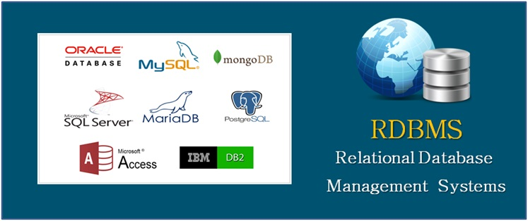
Relational Database Management System (RDMS)
Elaborée par : Maazaoui Boutheina

Slide 2
Plan
What is a RDBMS
MySQL : Definition and functionalities
PostgreSQL : Definition and functionalities
SQL SERVER : Definition and functionalities
Comparing between the three RDBMS

Slide 3
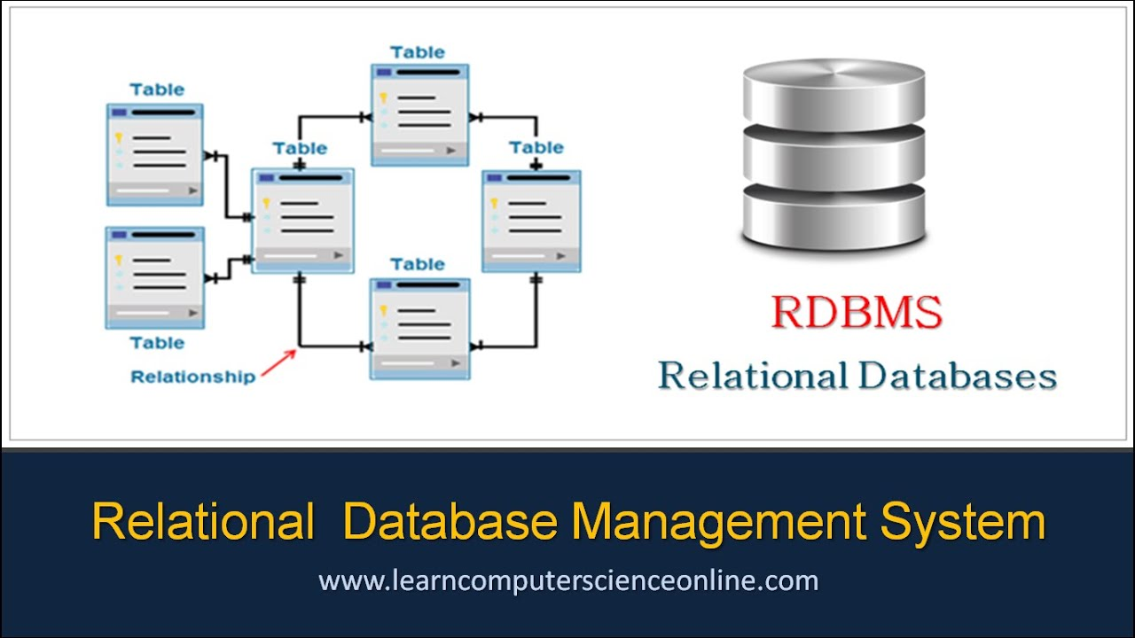
What is a RDBMS
In general, a database management system supports the development, administration and use of database.
Is an umbrella term for different types of DBMS : relational, hiararchical, NOSQL, etc.
A Relational DBMS is a type of DBMS that stores data in a row-based table strucuture which connects related data elements.
A RDBMS includes functions that maintain the security, accuracy, integrity and consistency of the data .

Slide 4
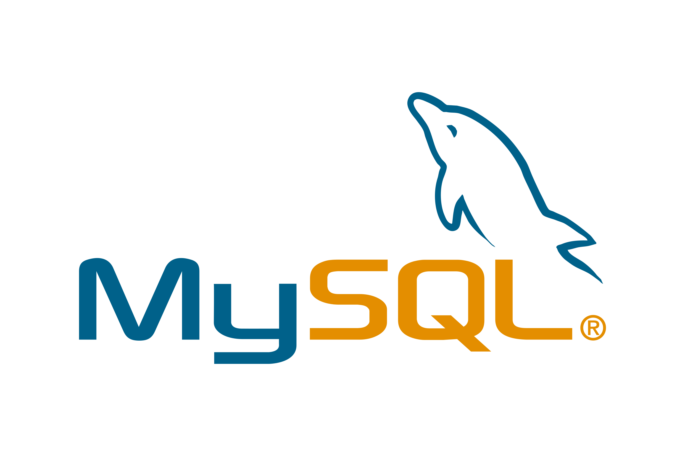
MySQL : Definition and functionalities
This is one of the most popular relational database systems.
Simple syntax and mild complexity: MySQL’s structure and style are very plain.
Partial open-source support.
Small web-based solutions : MySQL database system is the best option when you’re designing a small web application with a small volume of data.

Slide 5

PostgreSQL : Definition and functionalities
PostgreSQL (Postgres) is an open-source and free object-relational database management system(ORDBMS).
It has compliance with atomicity, consistency, isolation, durability (ACID) properties.
PostgreSQL supports advanced data types such as arrays and user defined types.
Great scalability, Easily-integrated third-party tools.

Slide 6
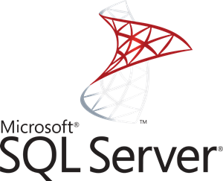
SQL SERVER : Definition and functionalities
Microsoft SQL Server is one of the most popular relational DBMS, in addition to MySQL, PostgreSQL, and Oracle.
It copes well with effective storing, changing, and managing relational data.
SQL Server is primarily built around a row-based table structure.
It has compliance with atomicity, consistency, isolation, durability (ACID) properties.

Slide 7
Comparing between the three RDBMS
An open source Relational Database Managment System (RDBMS) | An open-source and free Object-Relational Database Management System(ORDBMS). | It’s a commercial Relational Database Managment System (RDBMS)
Oracle Corporation developed MySQL. | PostgreSQL Global Development Group developed PostgreSQL. | SQL Server is developed by Saybase and Microsoft.
MySQL supports SQL standard data types. | PostgreSQL supports advanced data types. | SQL Server supports advanced data types.
Written in C, has a few C++ modules. | Written in C | Mostly C++ with a few exceptions
Easier | More complicated | Complicated

